Slide 1


Citizen Scientist Project iOS
Application 1.0
Team Members: David Gonzalez & Emmanuel Malave Product Owner: Nathan Moyer
Instructor: Masoud Sadjadi
School of Computing and Information Sciences Florida International University
Final Presentation
Spring 2018
Notes:
7 seconds.( I will select 2 best slides (i will give them extra points and students will present for CIS committee)
Greet your audience, thank them for attending your presentation, introduce yourself, introduce your project, introduce your team members, and quickly indicate what each of you did in a high-level manner, and put more emphasis on your part/contribution.

Slide 2
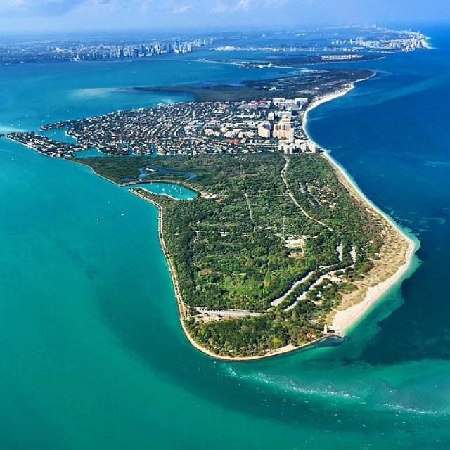
Project Overview
The Key Biscayne Citizen Scientist Project (CSP) mission is to have citizen and professional scientists monitor and protect resources and to share information on the most critical natural resources of Key Biscayne and Virginia Key.
The KeyScience iOS mobile app. is a portal to the many components operating to realize the Key Biscayne Community Foundation mission, and will become the launch pad for CSP Lecture Series and CSP Field Activities programs.
Notes:
10 seconds.
Introduce the problem that the whole project (in all versions) tackles with GIF or screenshot.

Slide 3
Project Overview: Continued
Extra Features
• Profile: offers the user the ability to update their name, create a bio or profile tagline, add a profile pic, and track their participation in the Geo Hunt.
• Record: the two current record features include a conditional form regarding bird sightings in and around Key Biscayne, and the ability to upload a photo with the user’s name, date, time, photo title, photo description, and GPS coordinates dynamically generated based on the user’s current location.
• Geo Hunt: a “geocaching” style educational game that shows users a map of Key Biscayne with destinations to travel to in order to learn more about our natural resources and earn points to their profile.
Notes:
20 seconds.
Introduce the problem that the your project (in new version) tackles with GIF or screenshot.

Slide 4
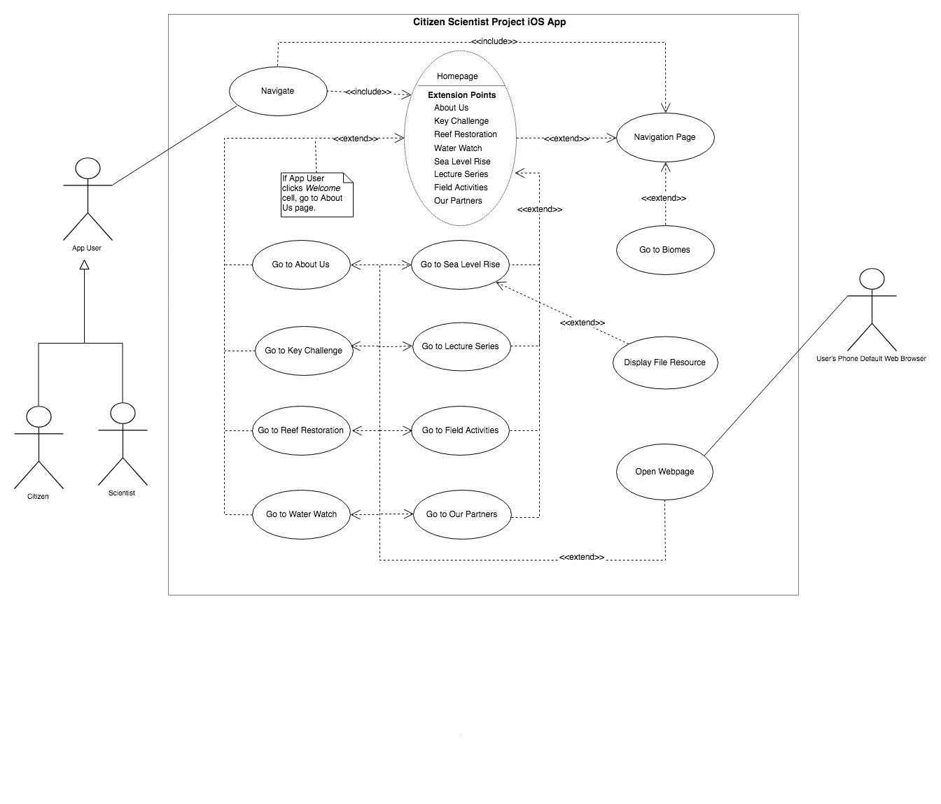
Requirements: Use Cases
Notes:
5 seconds
Show the Use Case Diagram for the whole project. Highlight your use cases.

Slide 5
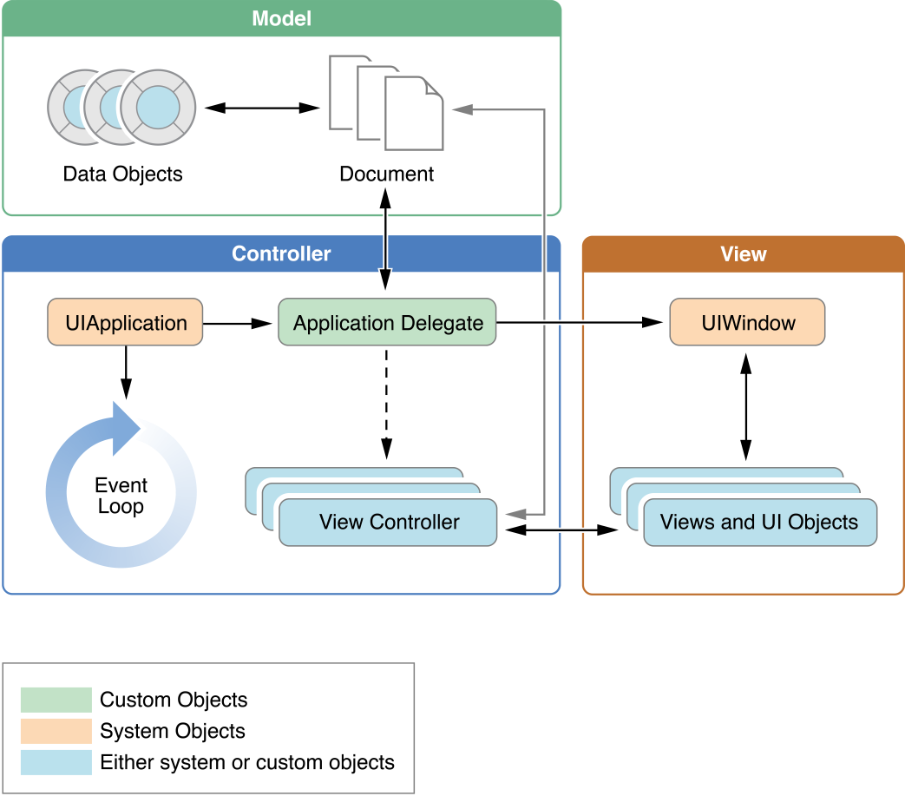
System Design: Architecture
Model: The model is responsible for directly managing the data, logic and rules of the application.
View: The view is responsible for representing the information (data model) with a number of defined UI elements. It also triggers events in response to user input.
Controller: Responds to the user input and performs interactions on the data model objects. It is responsible for binding and updating both the data model objects and the views (user interface).
Notes:
20 seconds
System design: Highlight the parts that you contributed to them.
1. System decomposition; identify the architecture patterns used
2. System deployment – h/w and s/w requirements

Slide 6
User Stories
1. #672 - Create Homepage
2. #671 - Create Reusable Social Media Footer View & Controller
3. #677 - Create Sea Level Rise Page
4. #676 - Create Water Watch Page
5. #712 - Expandable/Collapsable Homepage CSP Lab Cell
6. #674 - Create Mini Challenge Page
7. #675 - Create Previous Winners Page
8. #679 - Create Lecture Series Page
9. #680 - Create Field Activities Page
Notes:
5 seconds.
List the user stories that you worked on them.(put in order of importance). Stay focused on the parts that you have been working.

Slide 7
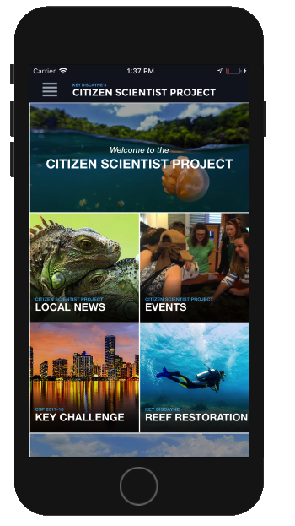
User Story #672
Create Homepage
Description:
As a user, I want a Homepage that showcases certain parts of the application, so that I can have quick & easy access to major areas of the app.
Acceptance Criteria:
Be built in a simple & scalable way.
There should be no broken links in any of the grid items.
When a grid item is clicked it should take you to the page it refers to.
Should be vertically scrollable.
Should be structured as a grid of images & text that link to specific sections of the app.
Labels must follow the style guideline provided.
Notes:
20 seconds
The tile of user story
Please present and show the complexity of your work, code, algorithms, and technical challenges and technologies you have used. (you could use screenshot if you want. Visual presentations are better than text presentation) - Go into the details of the most important/significant tasks using bullet lists or visual graphs or state chart diagram - Demo using screenshots or GIF (in another separate page if required)
Sequence Diagram for this user story is optional

Slide 8
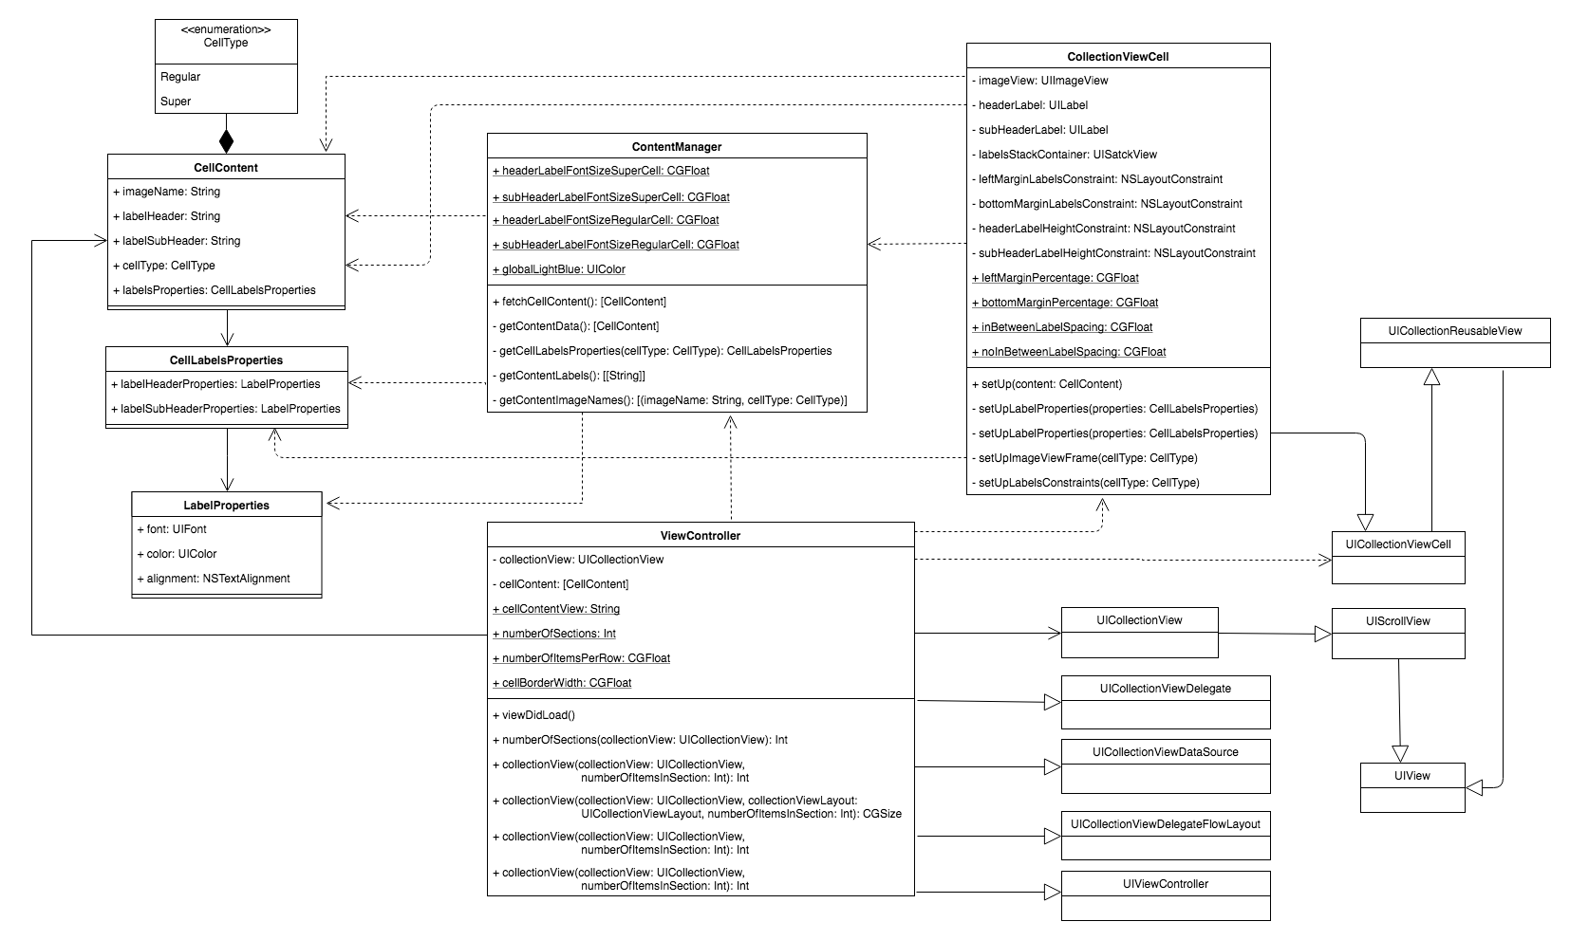
User Story #672 - Class Diagram
Create Homepage
Notes:
20 seconds
The tile of user story
Please present and show the complexity of your work, code, algorithms, and technical challenges and technologies you have used. (you could use screenshot if you want. Visual presentations are better than text presentation) - Go into the details of the most important/significant tasks using bullet lists or visual graphs or state chart diagram - Demo using screenshots or GIF (in another separate page if required)
Sequence Diagram for this user story is optional

Slide 9
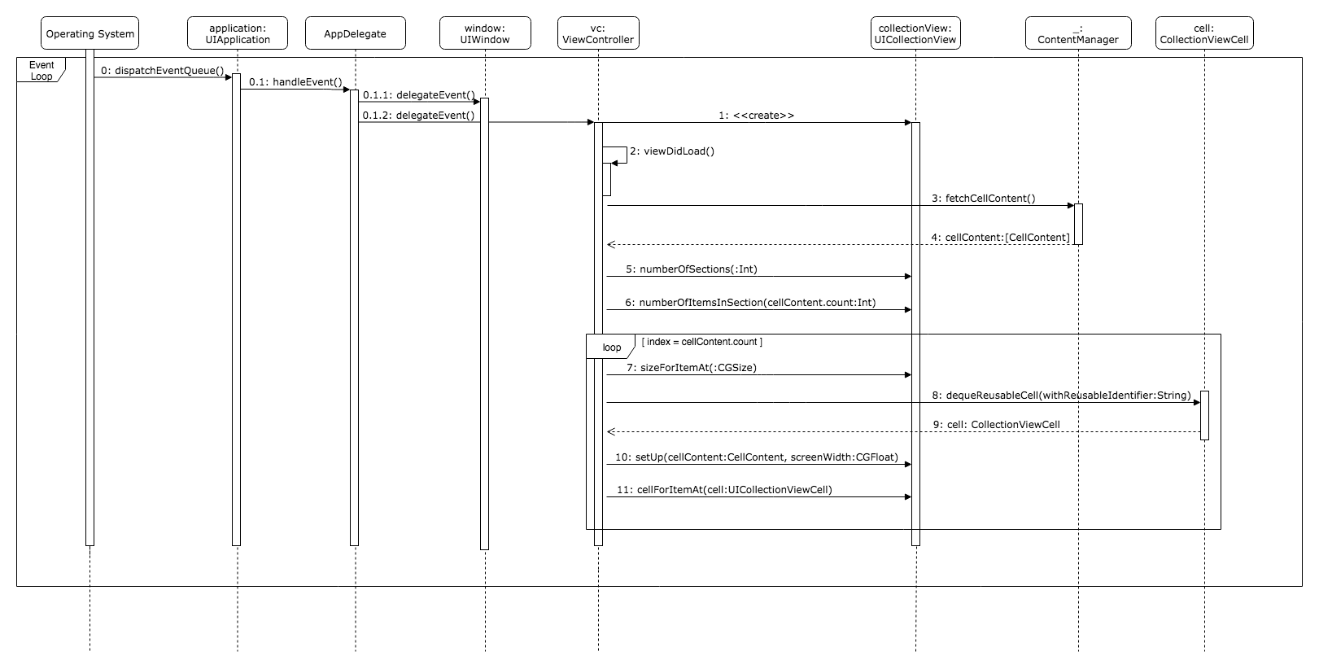
User Story #672 - Sequence Diagram
Create Homepage
Notes:
20 seconds
The tile of user story
Please present and show the complexity of your work, code, algorithms, and technical challenges and technologies you have used. (you could use screenshot if you want. Visual presentations are better than text presentation) - Go into the details of the most important/significant tasks using bullet lists or visual graphs or state chart diagram - Demo using screenshots or GIF (in another separate page if required)
Sequence Diagram for this user story is optional

Slide 10
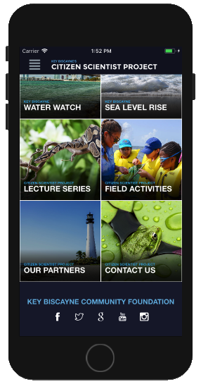
User Story #671
Create Reusable Social Media Footer View & Controller
Description:
As a user, I want a footer at the bottom of every page, so that I can recognize the foundation and connect to their social media if I would want to.
Acceptance Criteria:
Should contain all the social media icon links.
Fixed at the bottom of content, not bottom of screen.
Footer label must follow the style guideline provided.
The entire text of the footer label must be visible even on smaller devices.
Notes:
20 seconds
The tile of user story
Please present and show the complexity of your work, code, algorithms, and technical challenges and technologies you have used. (you could use screenshot if you want. Visual presentations are better than text presentation) - Go into the details of the most important/significant tasks using bullet lists or visual graphs or state chart diagram - Demo using screenshots or GIF (in another separate page if required)
Sequence Diagram for this user story is optional

Slide 11
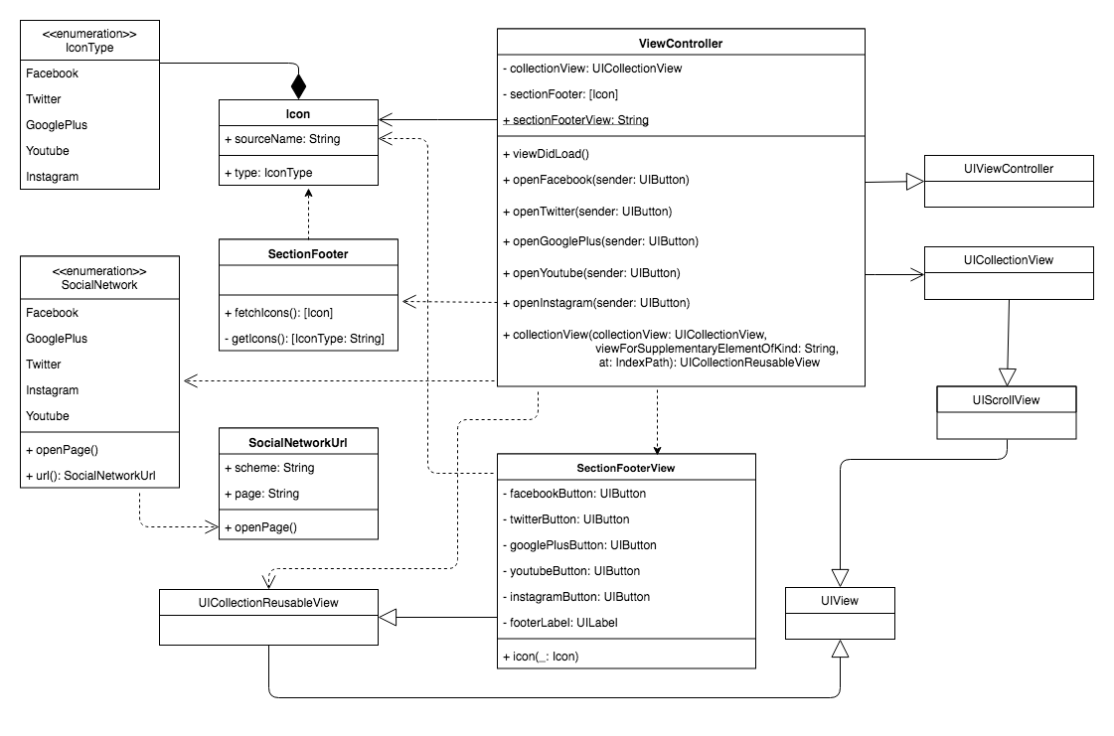
User Story #671 - Class Diagram
Create Reusable Social Media Footer View & Controller
Notes:
20 seconds
The tile of user story
Please present and show the complexity of your work, code, algorithms, and technical challenges and technologies you have used. (you could use screenshot if you want. Visual presentations are better than text presentation) - Go into the details of the most important/significant tasks using bullet lists or visual graphs or state chart diagram - Demo using screenshots or GIF (in another separate page if required)
Sequence Diagram for this user story is optional

Slide 12
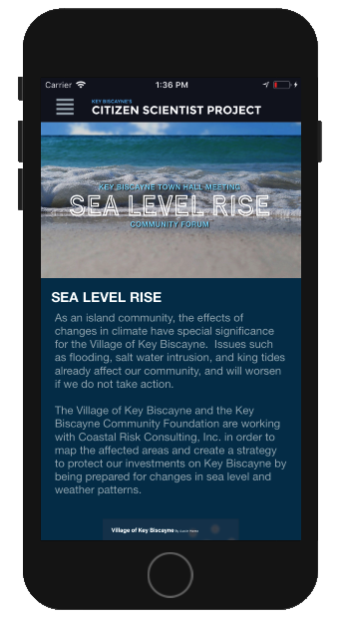
User Story #677
Create Sea Level Rise Page
Description:
As a user, I want a Sea Level Rise page that is populated with the content currently found on the website, so that I can have a way to track how sea level rise is affecting my community through the application.
Acceptance Criteria:
http://www.keyscience.org/projects/sea-level-rise/
The content should be presented in a single column layout with full width banner imagery while adding imagery within large bodies of written content aligned above or under it.
Should give access to all the documents linked to on the Sea Level Rise website page including various PDFs, YouTube videos, Prezi presentation, etc.
Notes:
20 seconds
The tile of user story
Please present and show the complexity of your work, code, algorithms, and technical challenges and technologies you have used. (you could use screenshot if you want. Visual presentations are better than text presentation) - Go into the details of the most important/significant tasks using bullet lists or visual graphs or state chart diagram - Demo using screenshots or GIF (in another separate page if required)
Sequence Diagram for this user story is optional

Slide 13
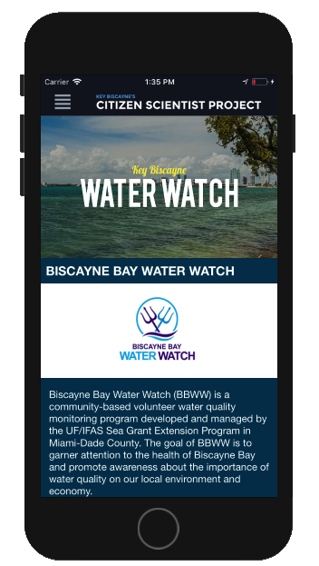
User Story #676
Create Water Watch Page
Description:
As a user, I want a Water Watch page that is populated with the content currently found on the website, so that I can have a way to track the information provided by the Water Watch program through the application.
Acceptance Criteria:
http://www.keyscience.org/projects/key-biscayne-water-watch/
Include the Biscayne Bay Water Watch logo Should be able to view the various graphs and charts as legible, static images.
Page should give access to access all the documents shown in the Water Watch website page, including various PDFs
Notes:
20 seconds
The tile of user story
Please present and show the complexity of your work, code, algorithms, and technical challenges and technologies you have used. (you could use screenshot if you want. Visual presentations are better than text presentation) - Go into the details of the most important/significant tasks using bullet lists or visual graphs or state chart diagram - Demo using screenshots or GIF (in another separate page if required)
Sequence Diagram for this user story is optional

Slide 14
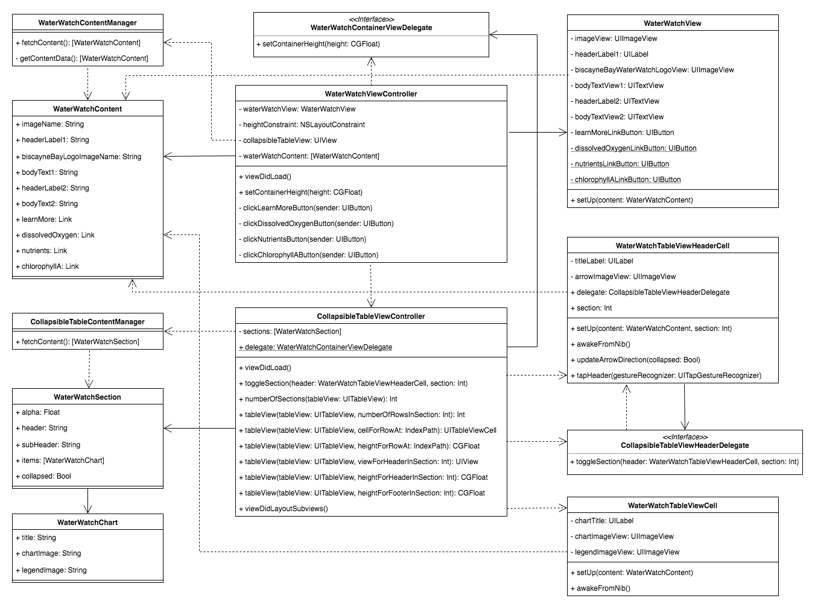
User Story #676 - Class Diagram
Create Water Watch Page
Notes:
20 seconds
The tile of user story
Please present and show the complexity of your work, code, algorithms, and technical challenges and technologies you have used. (you could use screenshot if you want. Visual presentations are better than text presentation) - Go into the details of the most important/significant tasks using bullet lists or visual graphs or state chart diagram - Demo using screenshots or GIF (in another separate page if required)
Sequence Diagram for this user story is optional

Slide 15
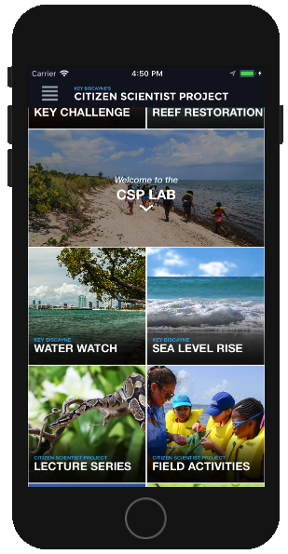
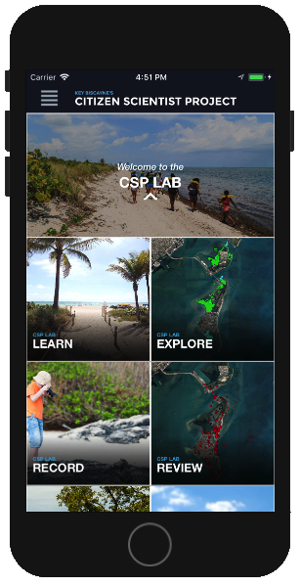
User Story #712
Expandable/Collapsable Homepage CSP Lab Cell
Description:
As a user, I would like the CSP Lab cell in the homepage to be expandable so that I can see the child pages.
Acceptance Criteria:
When the CSP Lab cell is expanded the following children elements should show: Learn, Explore, Record and Review.
When the CSP Lab cell is retracted the children elements should not be visible.
Closed Open
Notes:
20 seconds
The tile of user story
Please present and show the complexity of your work, code, algorithms, and technical challenges and technologies you have used. (you could use screenshot if you want. Visual presentations are better than text presentation) - Go into the details of the most important/significant tasks using bullet lists or visual graphs or state chart diagram - Demo using screenshots or GIF (in another separate page if required)
Sequence Diagram for this user story is optional

Slide 16
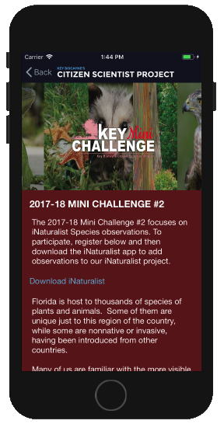
User Story #674
Create Mini Challenge Page
Description:
As a user, I want a Mini Challenge page with all the written content and imagery from the mini challenge website page, so that I can decide if I want to join a mini challenge.
Acceptance Criteria:
Be based on: (http://www.keyscience.org/projects/key-challenge/mini/)
The CSP, KBCF, and Fairchild logos should be displayed at the bottom of the page, like the website since this is a legal matter for the Foundation.
Should be a static page.
Notes:
20 seconds
The tile of user story
Please present and show the complexity of your work, code, algorithms, and technical challenges and technologies you have used. (you could use screenshot if you want. Visual presentations are better than text presentation) - Go into the details of the most important/significant tasks using bullet lists or visual graphs or state chart diagram - Demo using screenshots or GIF (in another separate page if required)
Sequence Diagram for this user story is optional

Slide 17
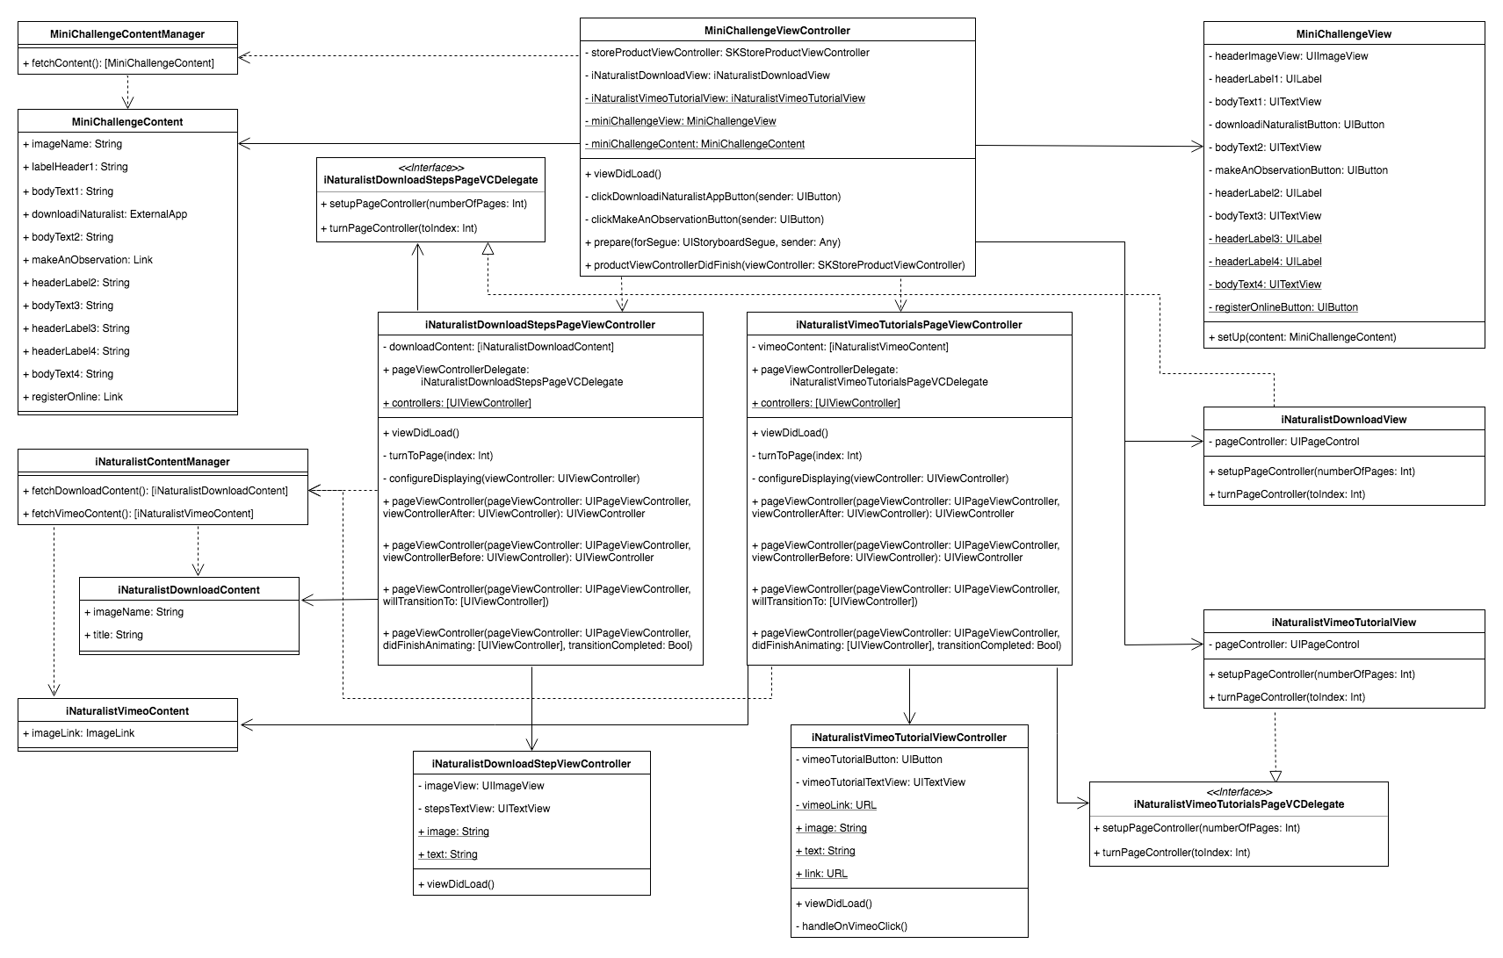
User Story #674 - Class Diagram
Create Mini Challenge Page
Notes:
20 seconds
The tile of user story
Please present and show the complexity of your work, code, algorithms, and technical challenges and technologies you have used. (you could use screenshot if you want. Visual presentations are better than text presentation) - Go into the details of the most important/significant tasks using bullet lists or visual graphs or state chart diagram - Demo using screenshots or GIF (in another separate page if required)
Sequence Diagram for this user story is optional

Slide 18
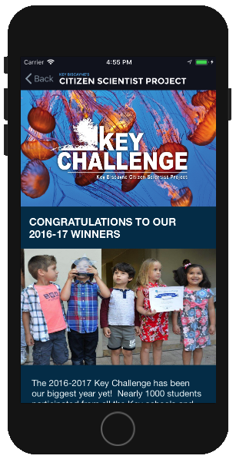
User Story #675
Create Previous Winners Page
Description:
As a user, I want a Previous Winners page that reflects all the content in the website, so that I can use this information as motivation to join a Key Challenge.
Acceptance Criteria:
http://www.keyscience.org/projects/key-challenge/2015-2016-key-challenge-winners/
The CSP, KBCF, and Fairchild logos should be displayed at the bottom of the page, like the website since this is a legal matter for the Foundation.
Content should be shown stacked vertically with expand/hide toggle button to the left of the name because horizontally tabbed content does not translate well to mobile devices.
Notes:
20 seconds
The tile of user story
Please present and show the complexity of your work, code, algorithms, and technical challenges and technologies you have used. (you could use screenshot if you want. Visual presentations are better than text presentation) - Go into the details of the most important/significant tasks using bullet lists or visual graphs or state chart diagram - Demo using screenshots or GIF (in another separate page if required)
Sequence Diagram for this user story is optional

Slide 19
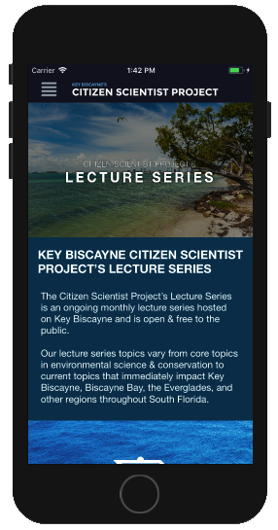
User Story #679
Create Lecture Series Page
Description:
As a user , I want a Lecture Series page that is populated with the content currently found on the website, so that I can have a way to see the lecture series through the application.
Acceptance Criteria:
http://www.keyscience.org/projects/key-biscayne-reef-restoration/
Don't have any of the links back to the Learn section included in the lecture item description.
Should be able to see the Lecture Series page presented in a single column layout
Should not have the Lecture Series Events feed on the Lecture Series page
Notes:
20 seconds
The tile of user story
Please present and show the complexity of your work, code, algorithms, and technical challenges and technologies you have used. (you could use screenshot if you want. Visual presentations are better than text presentation) - Go into the details of the most important/significant tasks using bullet lists or visual graphs or state chart diagram - Demo using screenshots or GIF (in another separate page if required)
Sequence Diagram for this user story is optional

Slide 20
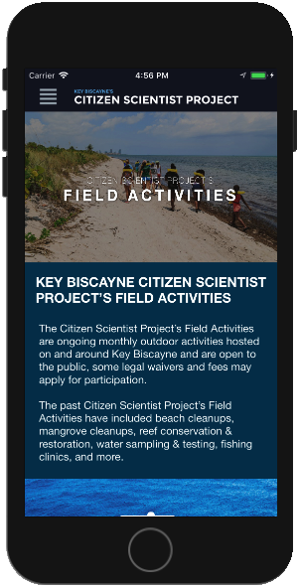
User Story #680
Create Field Activities Page
Description:
As a user, I want a Field Activities page that is populated with the content currently found on the website, so that I can find out about field activities hosted by The Foundation.
Acceptance Criteria:
http://www.keyscience.org/projects/csp-field-activities/
Should not have any of the links back to the Learn section included in the activity item description
Should not show the Field Activity Events feed on the Field Activities page
Should be able to see the Field Activities page presented in a single column layout.
Notes:
20 seconds
The tile of user story
Please present and show the complexity of your work, code, algorithms, and technical challenges and technologies you have used. (you could use screenshot if you want. Visual presentations are better than text presentation) - Go into the details of the most important/significant tasks using bullet lists or visual graphs or state chart diagram - Demo using screenshots or GIF (in another separate page if required)
Sequence Diagram for this user story is optional

Slide 21
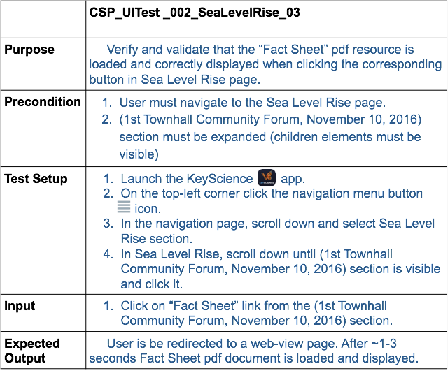
Test Suites and Test Cases
Notes:
10 seconds
A description of verification process and Test Suites and Test Cases for one of the use cases.
1 One sunny day and one rainy day for the implemented use cases (one or more slides).
2 Automated test scripts for the implemented use cases (if any) (one or more slides).

Slide 22








Thank You!
Contact Information
David Gonzalez, Application Developer - dgonz137@fiu.edu
Emmanuel Malave, Application Developer - emala003@fiu.edu
Nathan Moyer, Product Owner - nathanmoyer@lightmadeliquid.com
Notes:
10 seconds
Summarize your contribution, mention your effort for Scrum, Mingle, Github, Google Drive Documentation and minutes
Include your contact information
Ask if anyone has any questions for you.
Thank your audience

